Slide 1

Note: The data and information in this document is reflective of a hypothetical situation and client. This document is to be used for KPMG Virtual Internship purposes only.
Sprocket Central Pty Ltd
Data analytics approach
[Division Name] - [Engagement Manager], [Senior Consultant], [Junior Consultant]

Slide 2
Note: The data and information in this document is reflective of a hypothetical situation and client. This document is to be used for KPMG Virtual Internship purposes only.
Agenda
Introduction
Data Exploration
Model Development
Interpretation

Slide 3
Note: The data and information in this document is reflective of a hypothetical situation and client. This document is to be used for KPMG Virtual Internship purposes only.
Agenda
New Customer Analysis
We will visualize the data in the following areas:
Age Distributions
Number of Bike Purchases in The Past 3 Years
Job Industry Category
Wealth Segments
Number of Car Owns in Each States
Correlations Between Variables
Populations in Australia

Slide 4
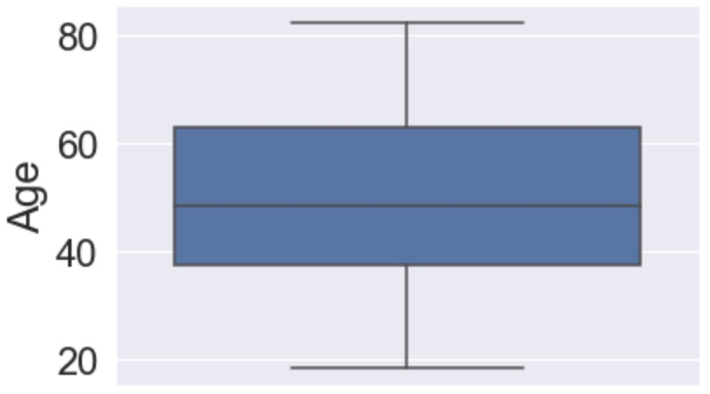
Note: The data and information in this document is reflective of a hypothetical situation and client. This document is to be used for KPMG Virtual Internship purposes only.
Data Exploration
Age Distributions
From the box plot beside, we can tell the new customer’s age distribution is normal, and almost Gaussian - without outliners, and the data tends to be around the central value.

Slide 5
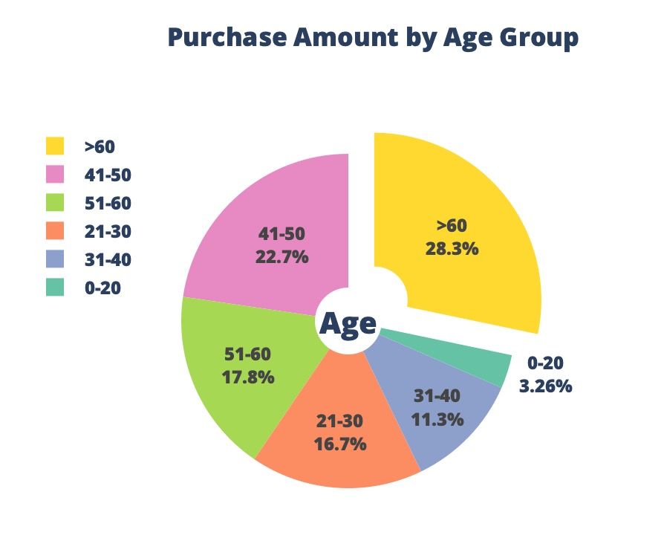
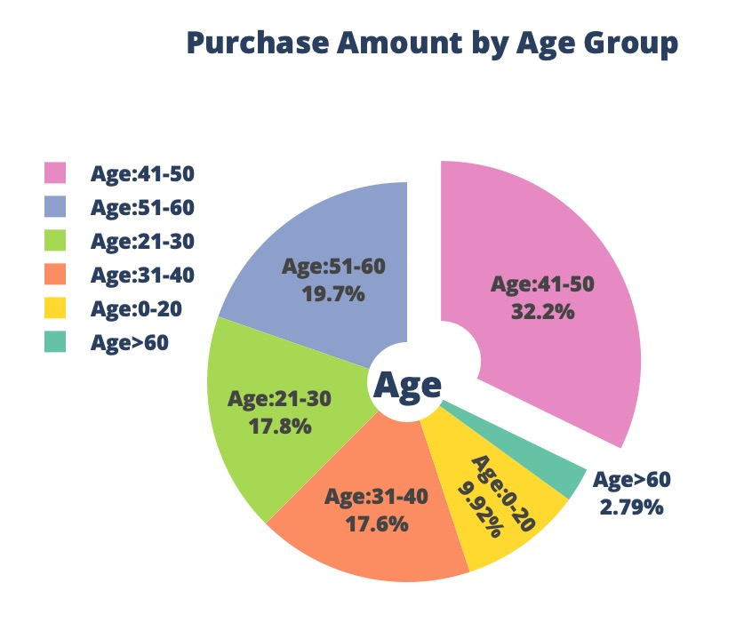
Note: The data and information in this document is reflective of a hypothetical situation and client. This document is to be used for KPMG Virtual Internship purposes only.
Data Exploration
From the pie Chart beside, it is obvious that new customer group aged 60 or above bought the most items in the past 3 years.
Previously it was the age group 41-50. Which means the main customer group is shifting to the more senior.

Slide 6
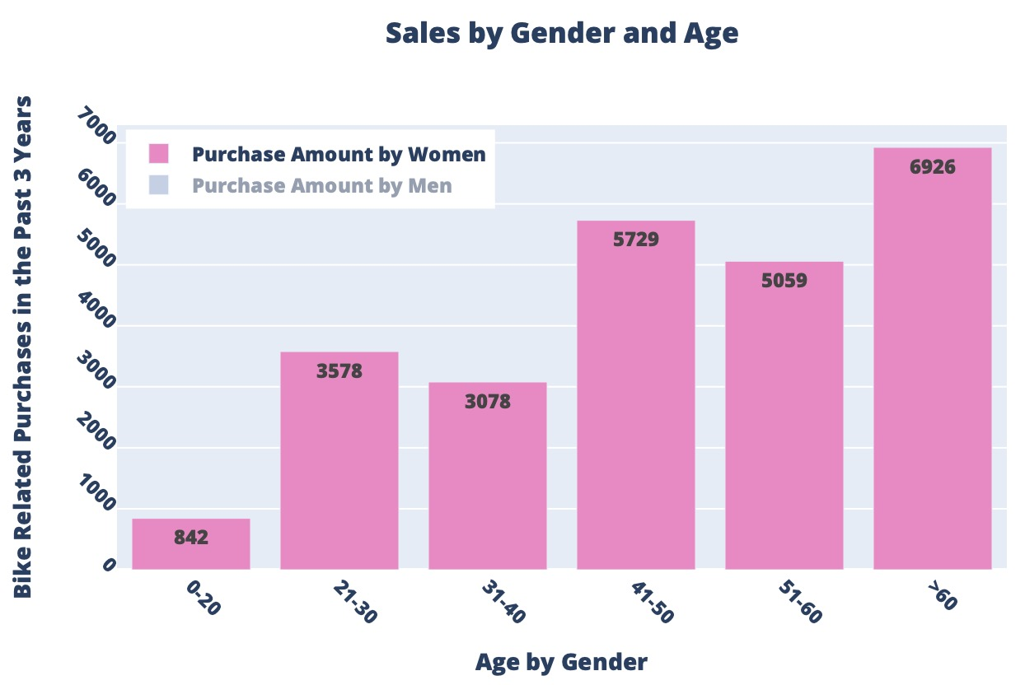
Note: The data and information in this document is reflective of a hypothetical situation and client. This document is to be used for KPMG Virtual Internship purposes only.
Data Exploration
Here is another visualization of the sales by gender and age.
So the company should focus on selling to the seniors.
The age groups between 41-60 should not be ignored to.
While they contributed a lot the company, they are the future target customer group soon.

Slide 7
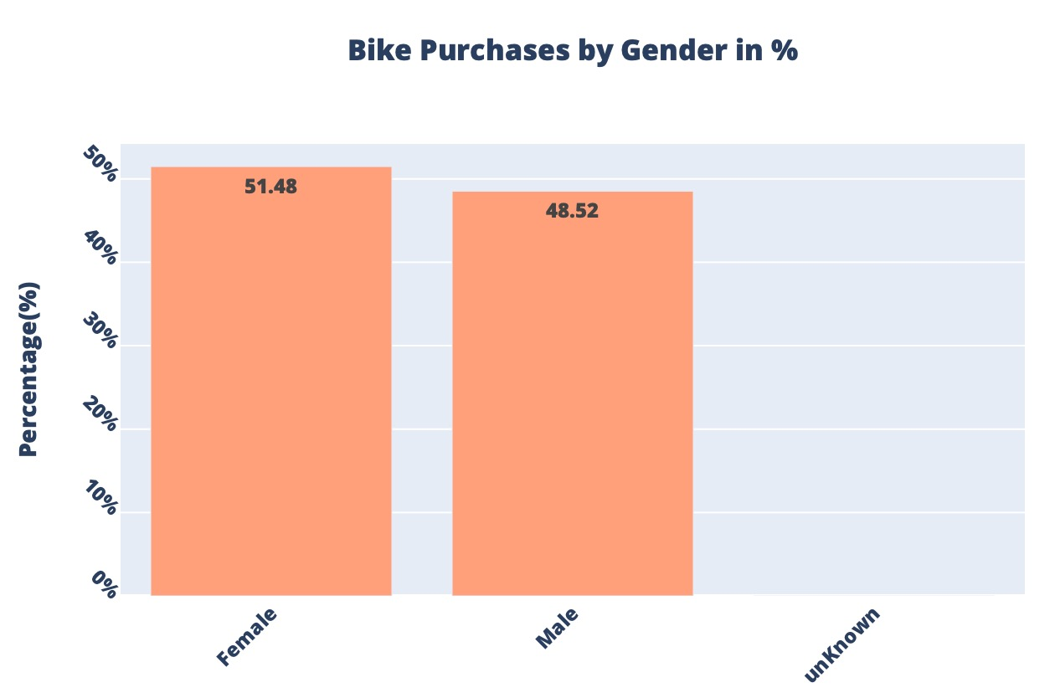
Note: The data and information in this document is reflective of a hypothetical situation and client. This document is to be used for KPMG Virtual Internship purposes only.
Data Exploration
Number of Bike Purchases in The Past 3 Years
The new customers are mainly female, 51.48%, while the male is 48.52%.
However the difference is small.

Slide 8
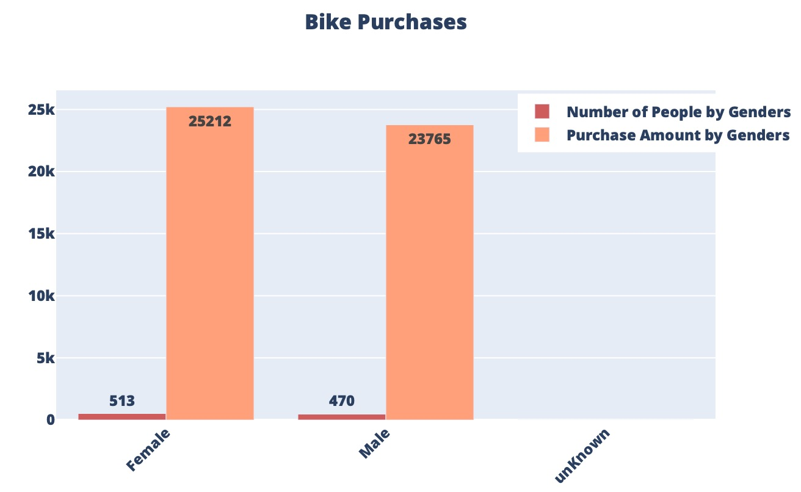
Note: The data and information in this document is reflective of a hypothetical situation and client. This document is to be used for KPMG Virtual Internship purposes only.
Data Exploration
Number of Bike Purchases in The Past 3 Years
The actually bike related purchases was 25212 for the female, while the male lagged behind with 23765.
The actual amount of female customers are higher too.
Obviously the female is more a target customer group to Sprocket Central Pty Ltd than the male.

Slide 9
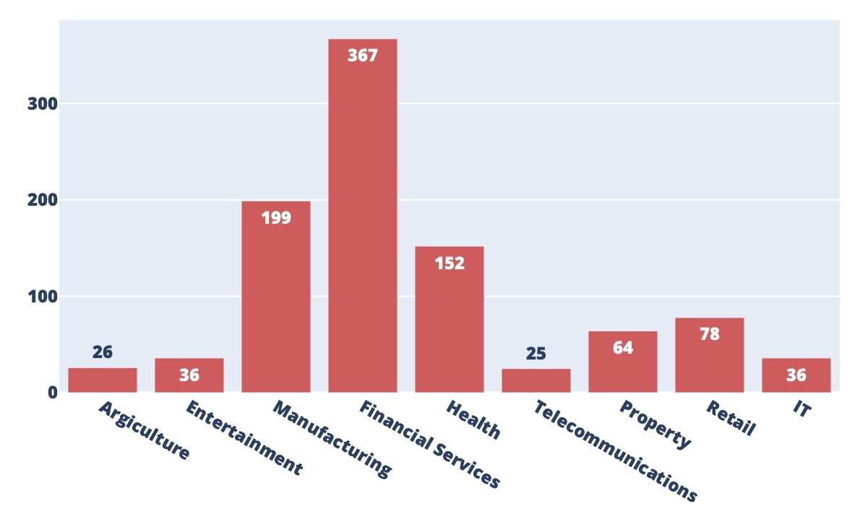
Note: The data and information in this document is reflective of a hypothetical situation and client. This document is to be used for KPMG Virtual Internship purposes only.
Data Exploration
Job Industry Category Investigation
Our analysis here shows a bigger Financial Services group, because we filled the N/A with the mode. However, it is still the biggest even if the fill isn’t there.
The Second most popular industry is the Manufacturing.
So the company should focus place more ads in the financial media.

Slide 10
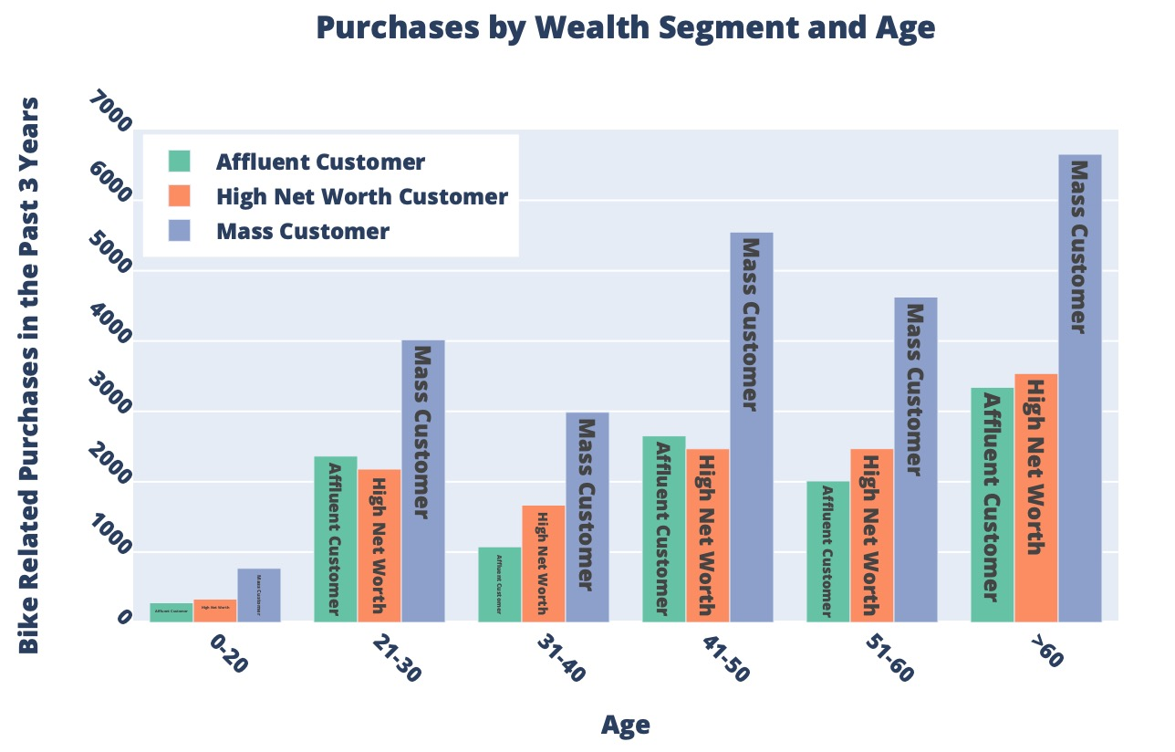
Note: The data and information in this document is reflective of a hypothetical situation and client. This document is to be used for KPMG Virtual Internship purposes only.
Data Exploration
Wealth Segment Investigation
The Mass Customer group dominates in each age groups, while they bought the most in the past 3 years.
However the actual money return may not be the biggest for the group, more investigations are needed.
But it is alright to target at them.

Slide 11
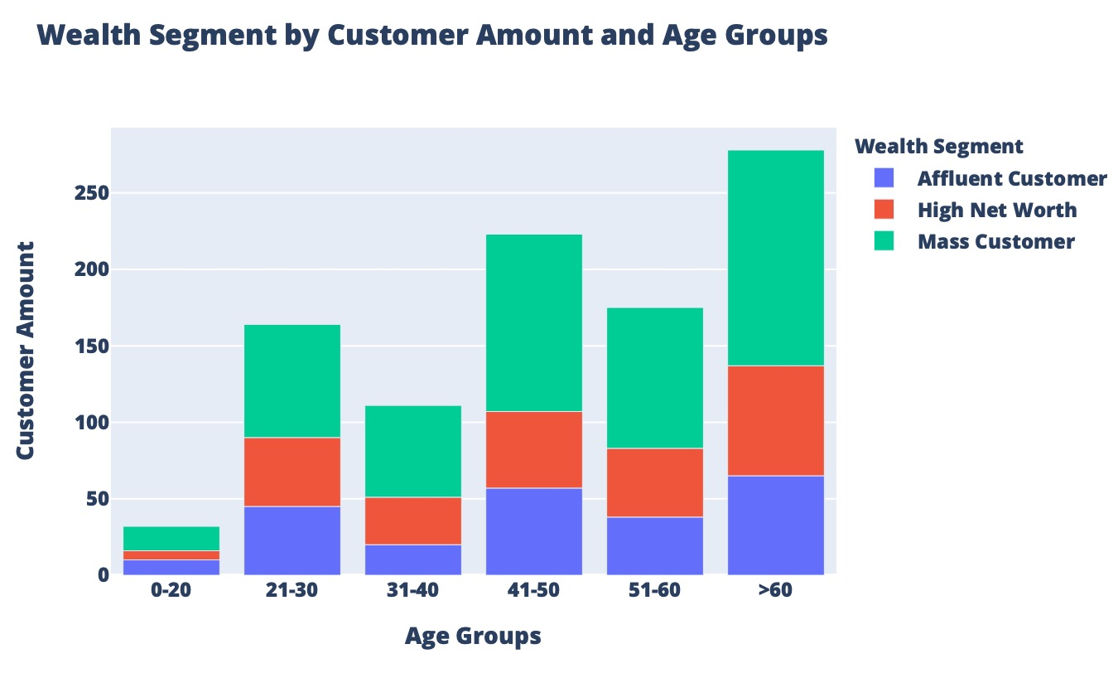
Note: The data and information in this document is reflective of a hypothetical situation and client. This document is to be used for KPMG Virtual Internship purposes only.
Data Exploration
Wealth Segment Investigation by Age
Again, the Mass Customer group make up the biggest contributor in terms of customer amount.
That’s why it is alright to target at them.

Slide 12
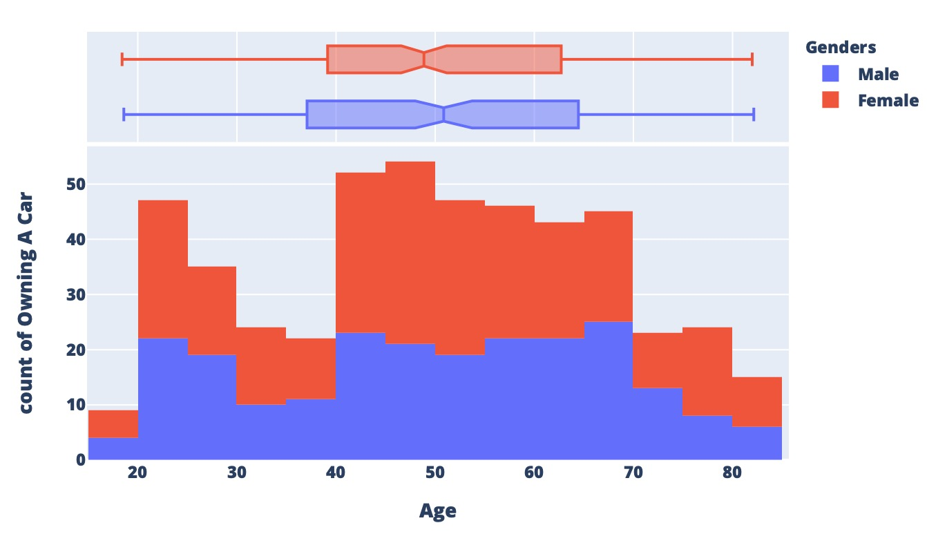
Note: The data and information in this document is reflective of a hypothetical situation and client. This document is to be used for KPMG Virtual Internship purposes only.
Data Exploration
Number of Car Owns in Each States
More females own a car than the male.
However the company should not focus on the carless group.
The reason is in the next slide.

Slide 13
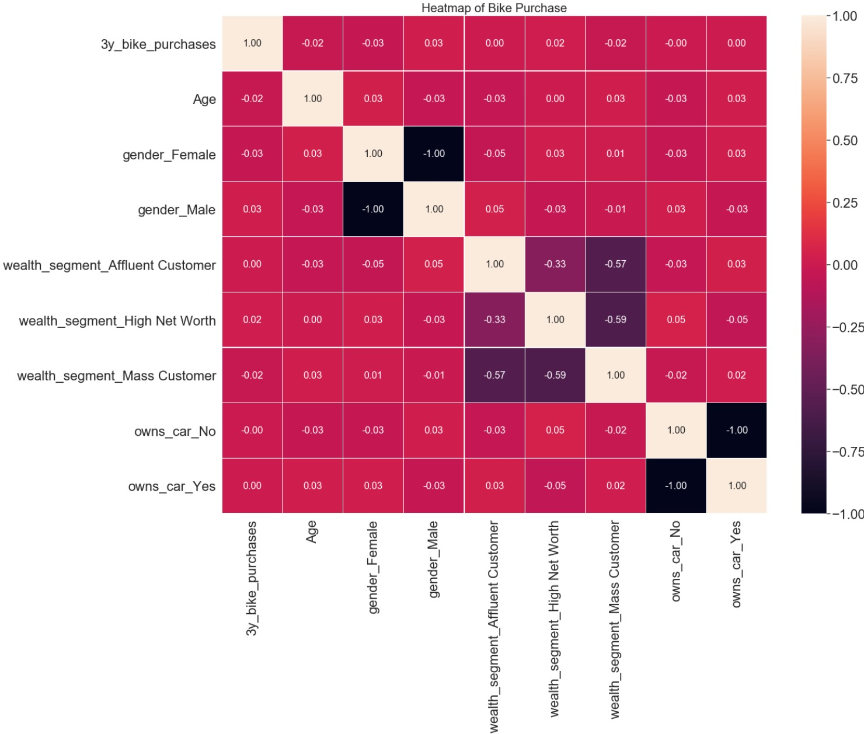
Note: The data and information in this document is reflective of a hypothetical situation and client. This document is to be used for KPMG Virtual Internship purposes only.
Data Exploration
Correlations Between Variables
The heatmap on the right shows the correlations between variables.
It shows that variables are generally unrelated to each other.
Whether the customers own a car or not does not affect their bike buying.

Slide 14
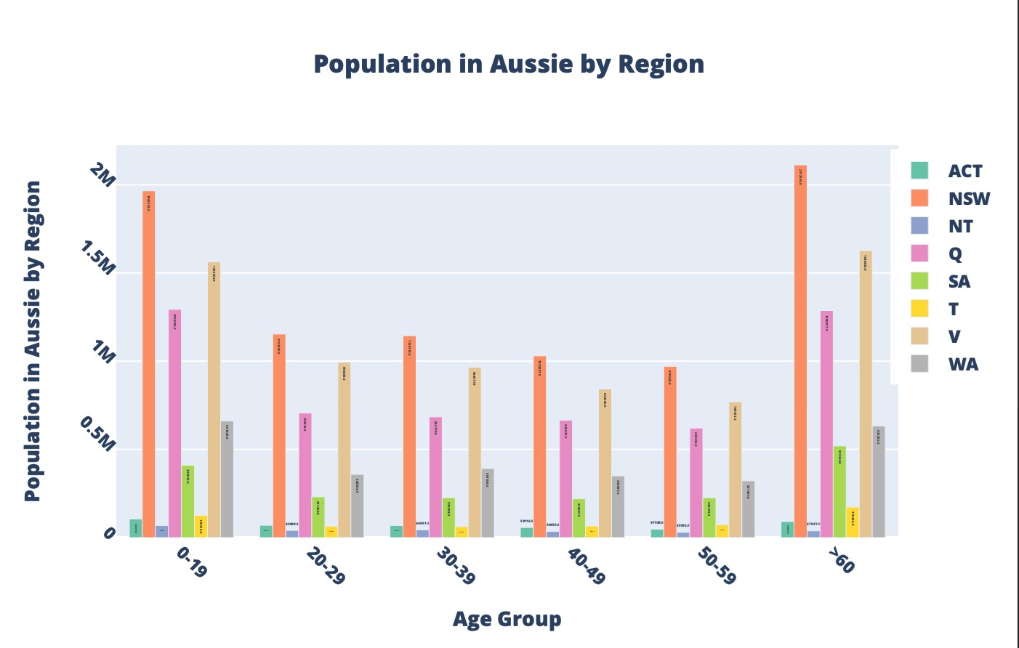
Note: The data and information in this document is reflective of a hypothetical situation and client. This document is to be used for KPMG Virtual Internship purposes only.
Data Exploration
Population in Australia

Slide 15
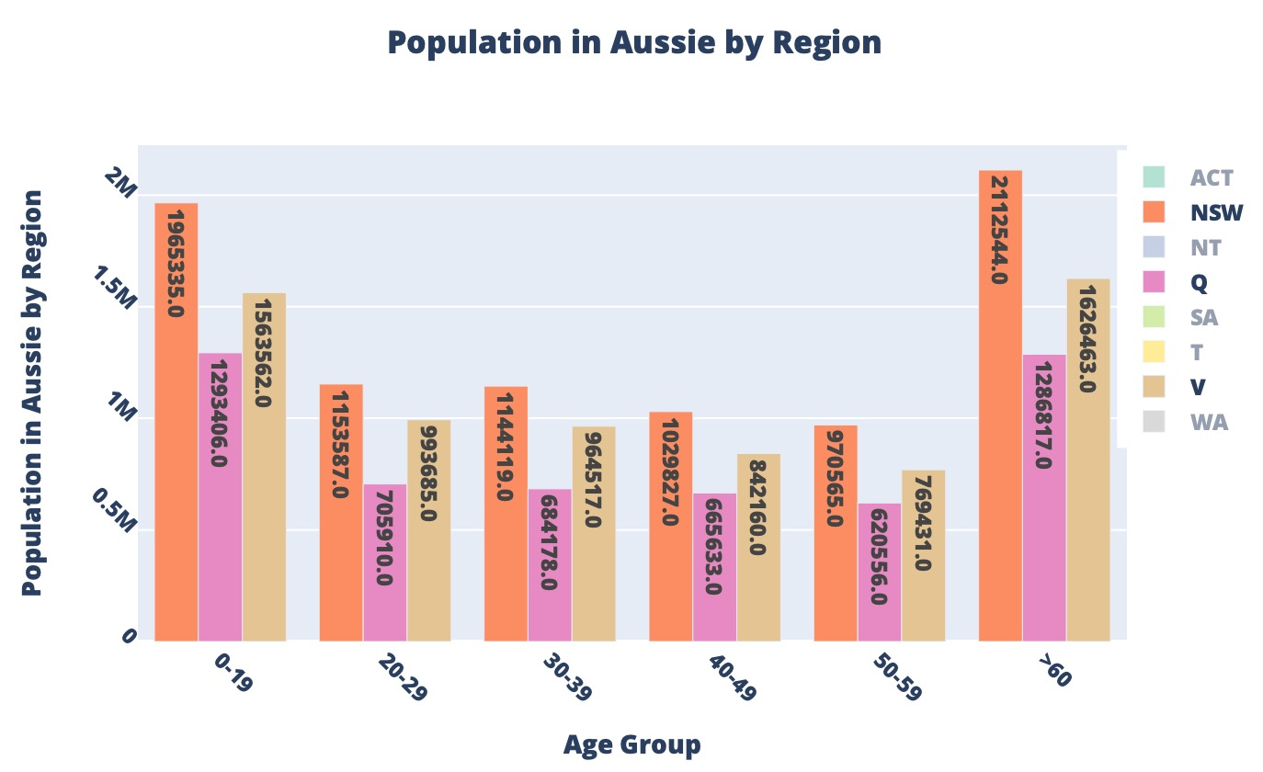
Note: The data and information in this document is reflective of a hypothetical situation and client. This document is to be used for KPMG Virtual Internship purposes only.
Data Exploration
Population in Australia
This graph is the same as the previous, just we will focus on the 3 most populated states here.
While the company’s customers are mainly above age 60, it should invest the most in New South Wales.
This state also has the most population in age 40-59 too.
The second state the company should focus is Victoria.

Slide 16
Note: The data and information in this document is reflective of a hypothetical situation and client. This document is to be used for KPMG Virtual Internship purposes only.
Appendix

Slide 17
Note: The data and information in this document is reflective of a hypothetical situation and client. This document is to be used for KPMG Virtual Internship purposes only.
Appendix

